Slide 1
Parameterization and Classification of AFM Images by Texture Analysis
A k-NN model to predict image parameters and ordering influencing factors at bio/nano interfaces
Sid Rath
Christopher Nyambura
Sarthak Jariwala
Demi Liu

Slide 2
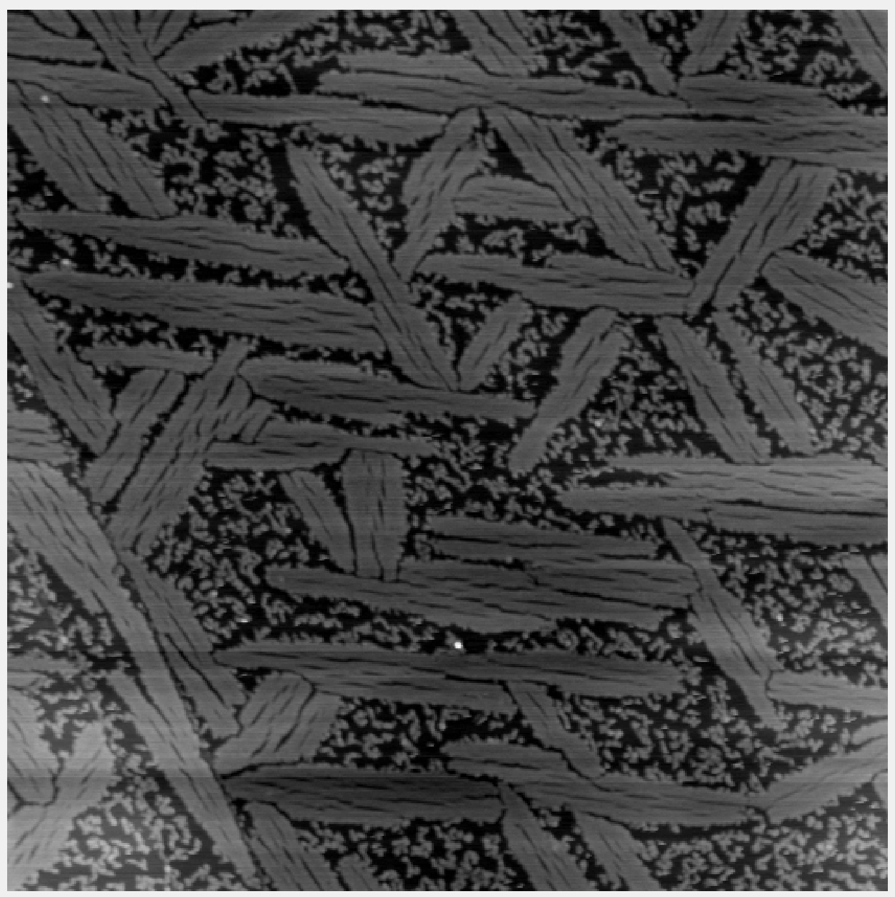
Our Data
1. AFM Images taken in GEMSEC* labs
Genetically Engineered Peptides
Atomically flat surfaces
subsampling to 64x64
64 images from 1 image: ~6400 images
Subsequent stitching after prediction
# ~ 100, 512x512 pixels each
*GEMSEC PI: Prof Mehmet Sarikaya, images taken by grad students in the group.

Slide 3
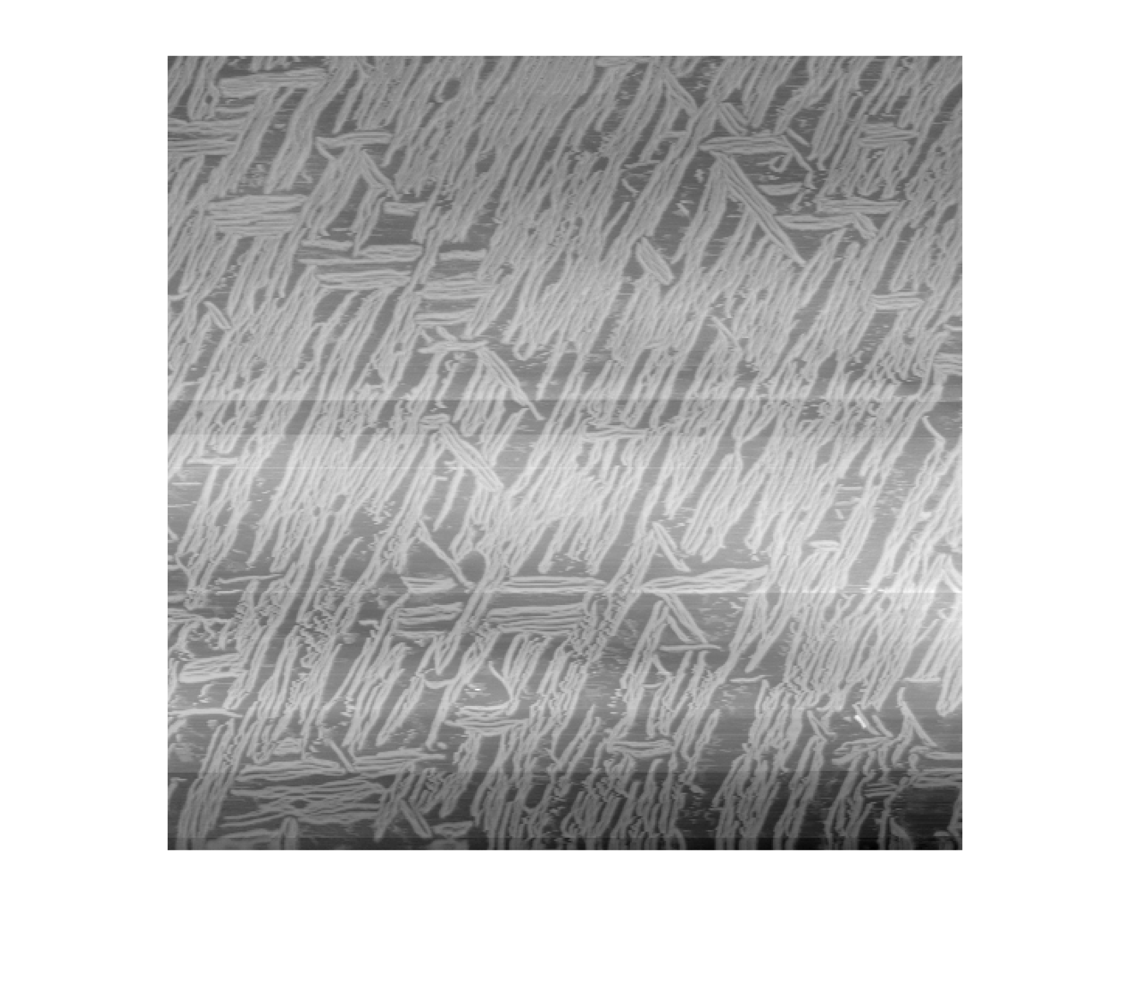
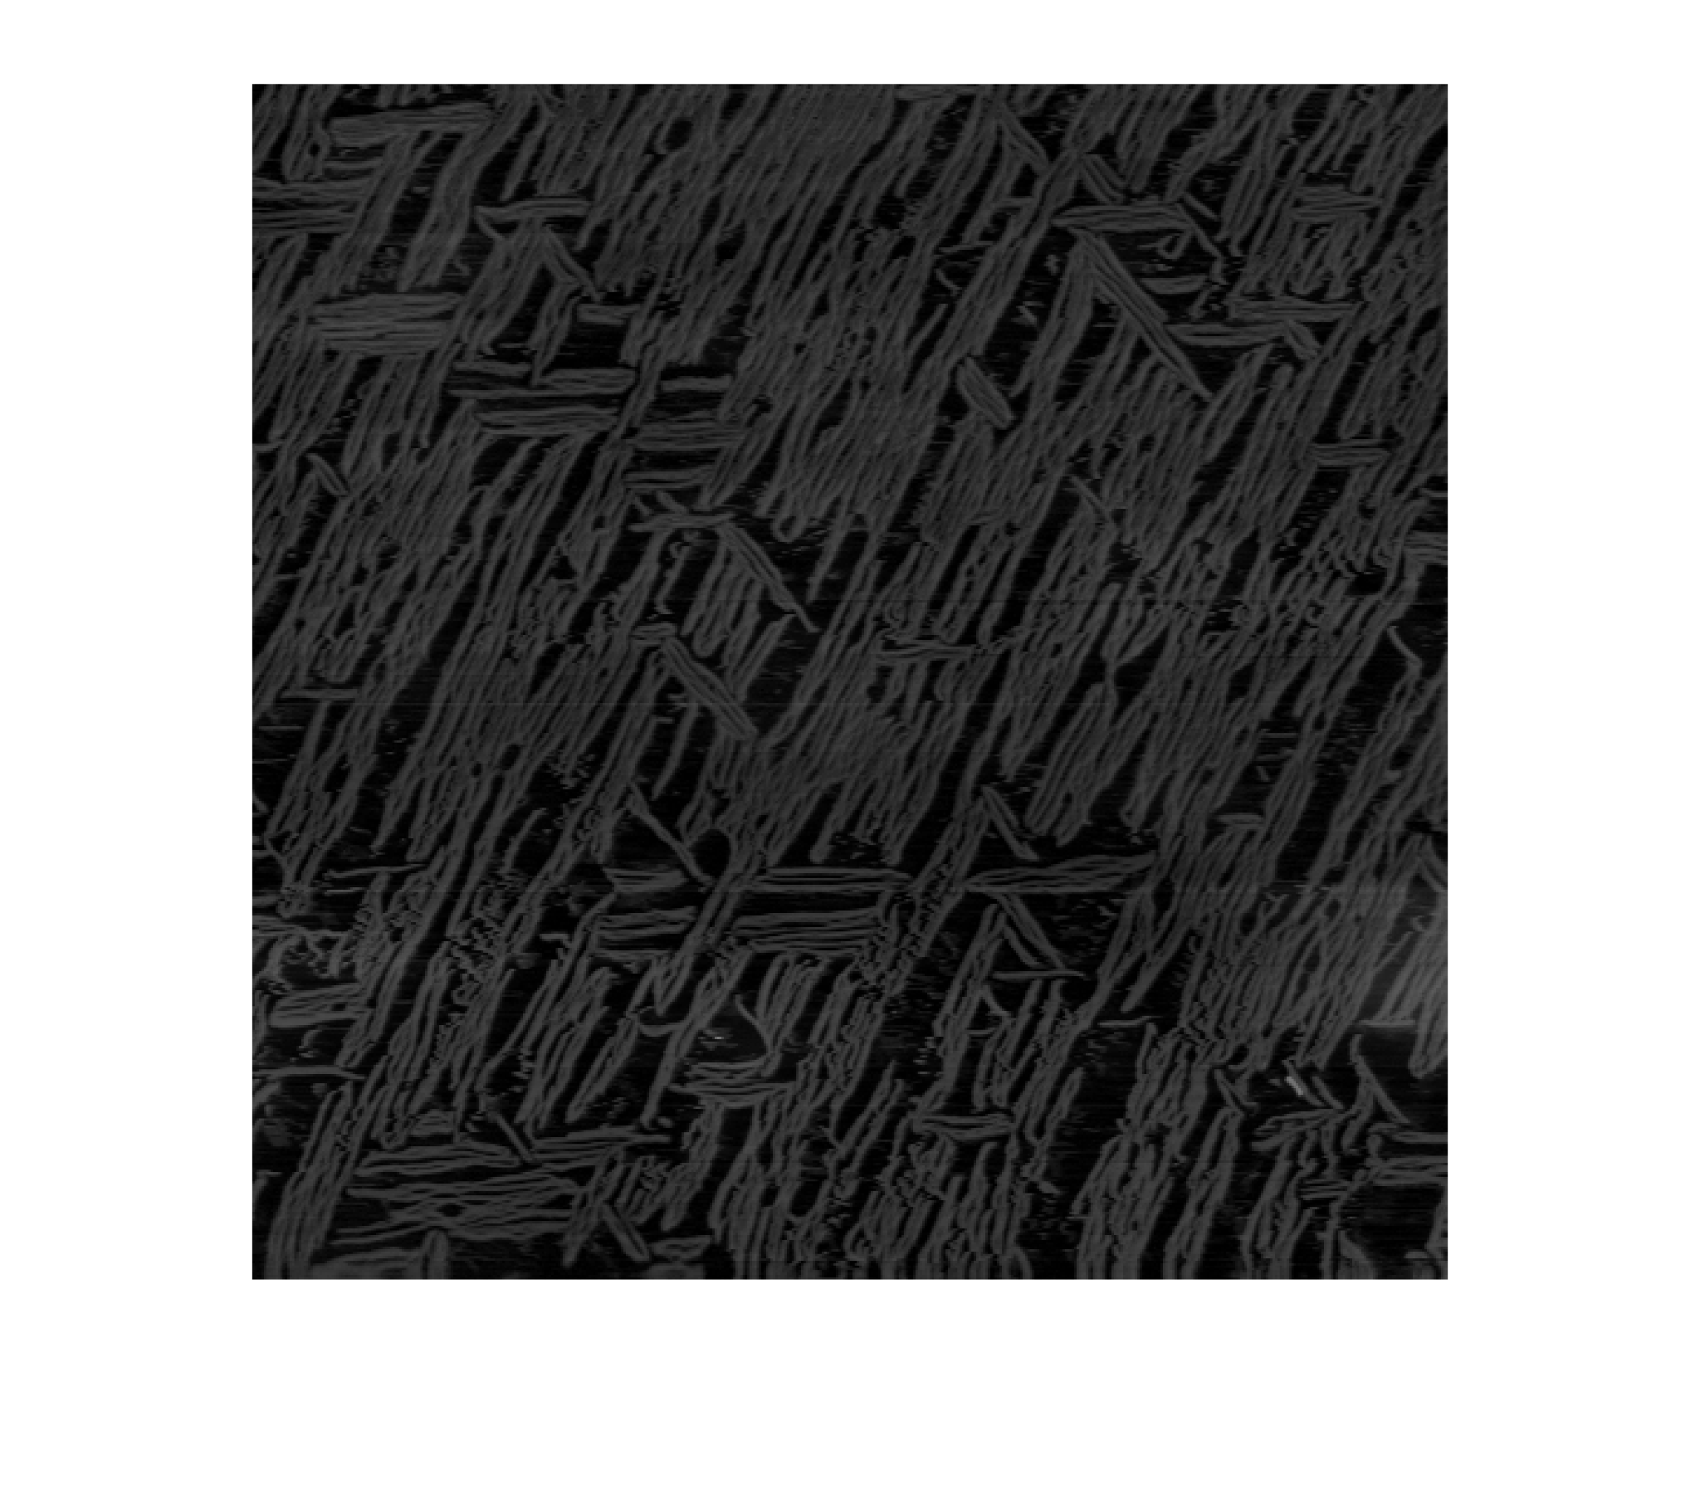


Background correction
a
c
a
c
b
d
b
d
Grayscale
Surface plots

Slide 4
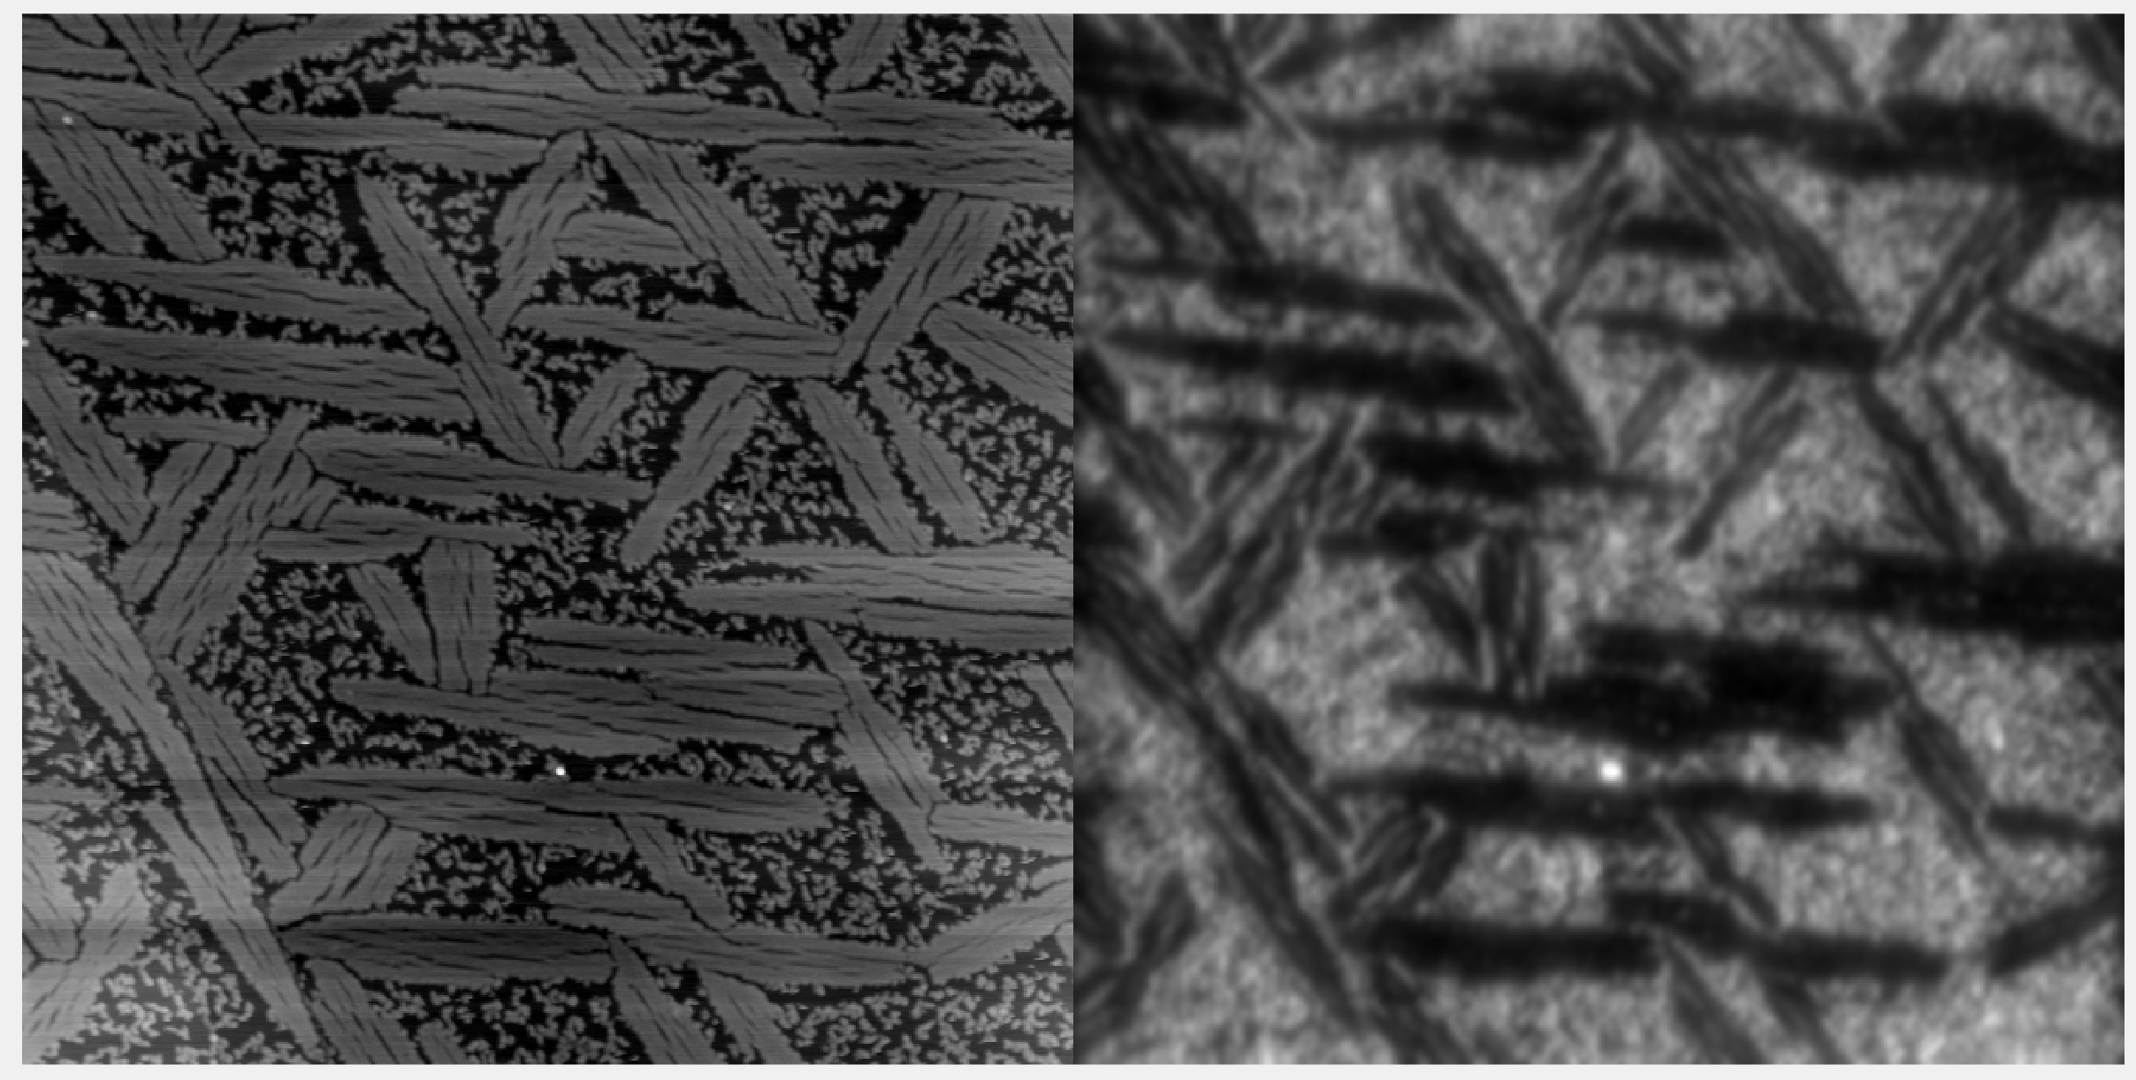
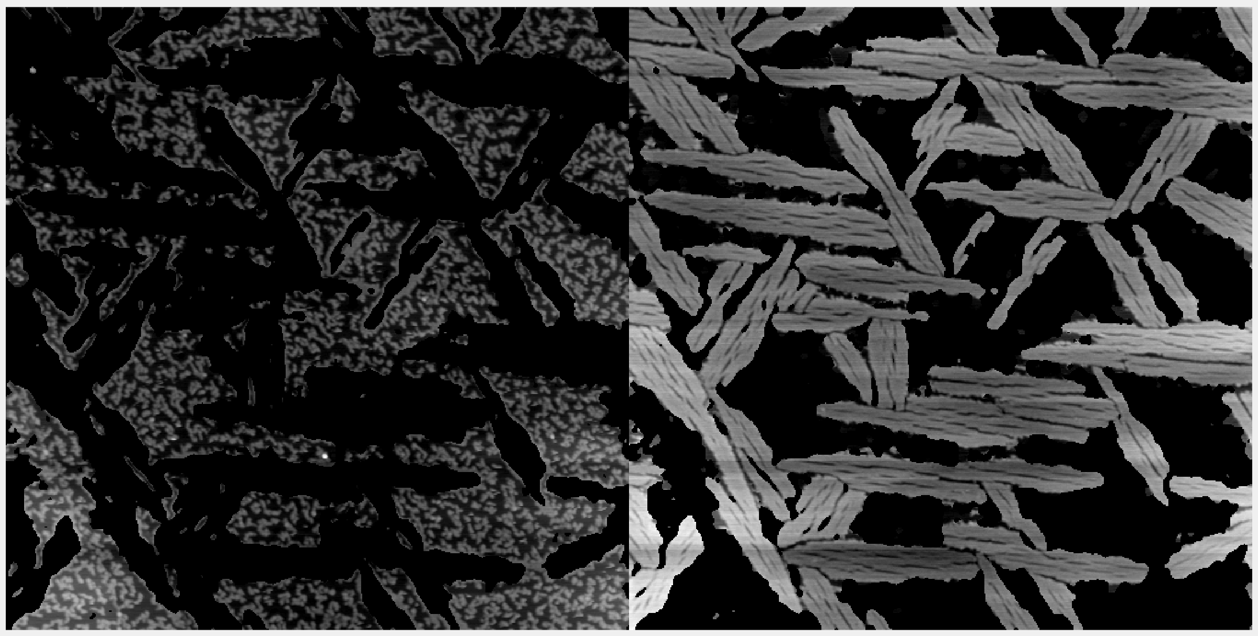
Segmentation using Gabor-filters, K-means
Gabor Filters de-noise and pick out frequencies
%coverage of peptides: 77%
%coverage of ordered phase: 71.25%
Order:disorder ratio 1.78

Slide 5
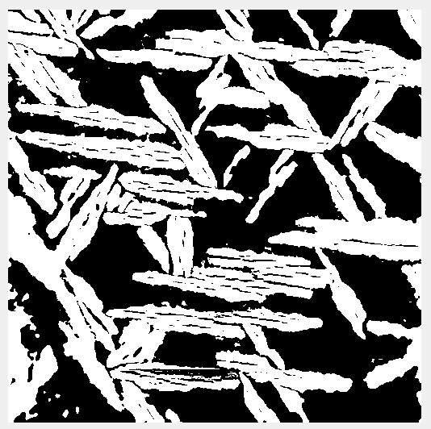
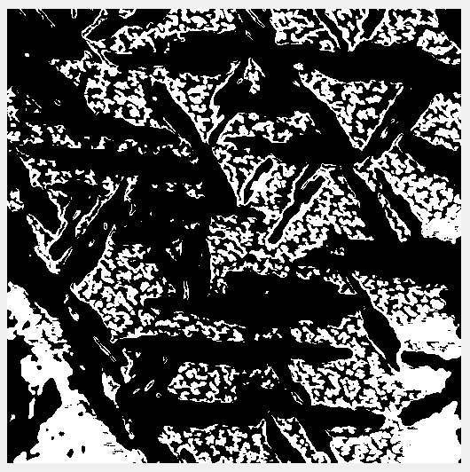
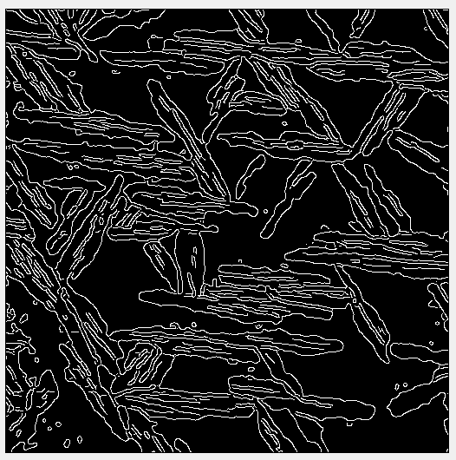
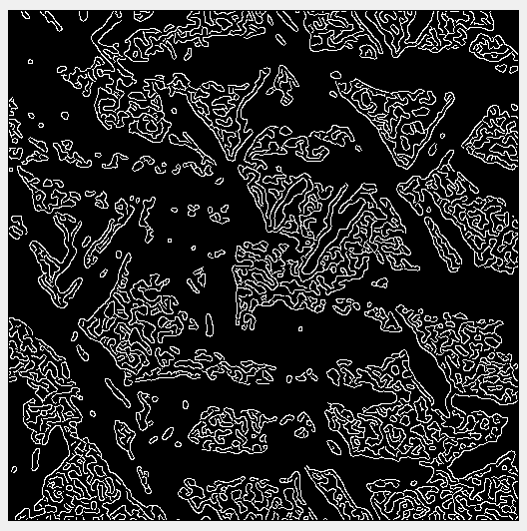
Edge detection and binarization for parameterization

Slide 6
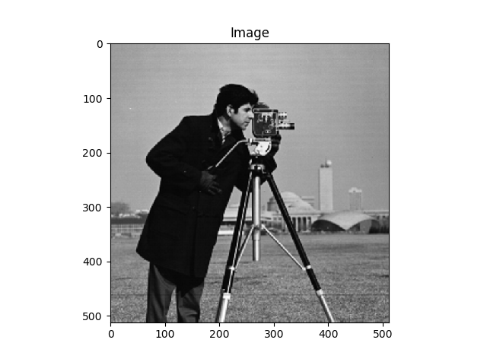
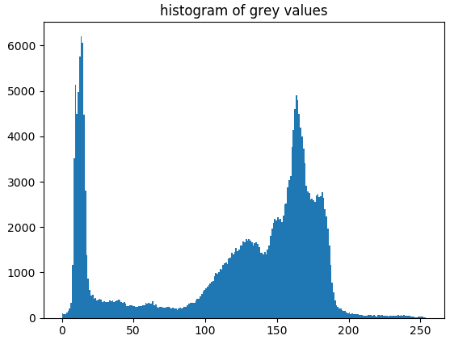
Skimage - Image Segmentation
Goal: Segment two peptide domains in the image
Limit of thresholding segmentation:
the domains share
a range of grey values
Method in skimage:
Edge-based segmentation
Region-based segmentation
Random walker segmentation

Slide 7
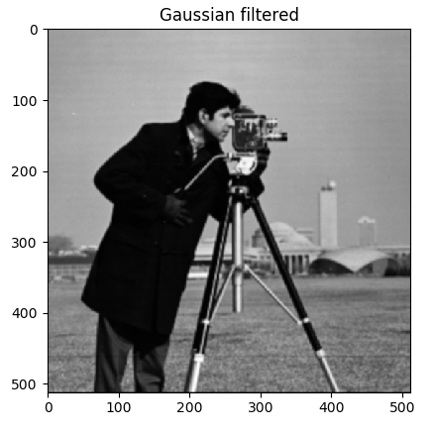
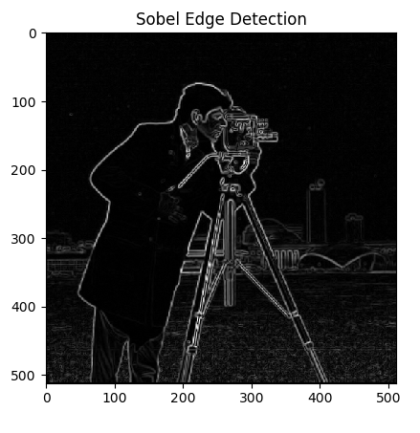
Edge-based segmentation using Canny detector
Process:
Apply Gaussian filter to smooth the image
Calculate the intensity gradients of the image using Sobel operators (skimage.filters.sobel)

Slide 8
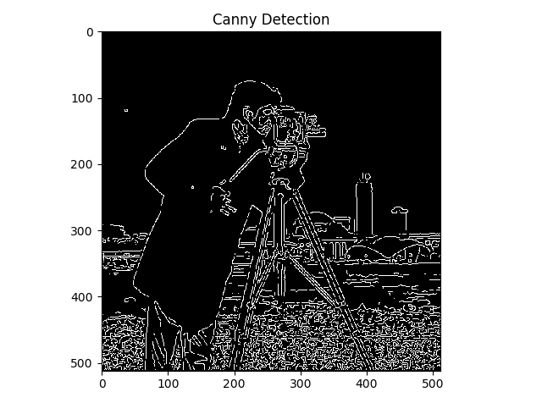
3. Thinning potential edges to 1-pixel wide curves:
Find the normal to the edge at each point
Look for values in the normal and reverse directions that are greater than the point
4. Detect edges by hyeteresis: only strong edges are kept

Slide 9
Edge-based Segmentation
skimage.feature.canny
Parameters
image | 2-D array, grey-scale
sigma | Standard deviation of the Gaussian filter
low_threshold | Lower bound for hysteresis thresholding. Default = 10% of dtype’s max
high_threshold | Upper bound for hysteresis thresholding. Default = 20% of dtype’s max
mask | Limit the Canny to a certain area
use_quantiles | Treat low_threshold and high_threshold as quantiles of the edge magnitude image

Slide 10
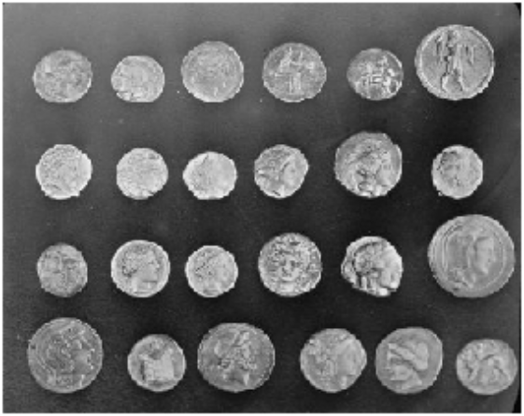
Region-based Segmentation
Example Image:
Background and coin pixels share enough grey levels that a thresholding segmentation would not perform well
http://scikit-image.org/docs/stable/user_guide/tutorial_segmentation.html
https://en.wikipedia.org/wiki/Watershed_%28image_processing%29
Notes:
Markers: - pixels that we can label unambiguously as either object or background.
- found at the two extreme parts of the histogram of grey values
Watershed transformation: - floods an image of elevation starting from markers, in order to determine the catchment basins of these markers
- Aim is to have high barriers effectively separate the coins from the background.

Slide 11
Region-based Segmentation
Example Image:
1) Determine markers (labelled pixels) specific to the coin and background
Background and coin pixels share enough grey levels that a thresholding segmentation would not perform well
http://scikit-image.org/docs/stable/user_guide/tutorial_segmentation.html
https://en.wikipedia.org/wiki/Watershed_%28image_processing%29
Notes:
Markers: - pixels that we can label unambiguously as either object or background.
- found at the two extreme parts of the histogram of grey values
Watershed transformation: - floods an image of elevation starting from markers, in order to determine the catchment basins of these markers
- Aim is to have high barriers effectively separate the coins from the background.

Slide 12
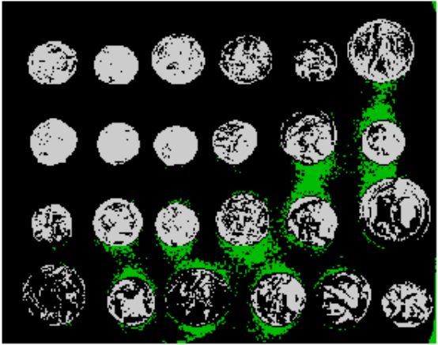


Region-based Segmentation
Example Image:
1) Determine markers (labelled pixels) specific to the coin and background
2) Perform a watershed transformation on the labelled pixels
3) Determine the catchment basins based on watershed transform
- Calculate the amplitude of the pixel gradient from the markers
- Connect markers of high intensity to determine boundaries
Background and coin pixels share enough grey levels that a thresholding segmentation would not perform well
http://scikit-image.org/docs/stable/user_guide/tutorial_segmentation.html
https://en.wikipedia.org/wiki/Watershed_%28image_processing%29
Notes:
Markers: - pixels that we can label unambiguously as either object or background.
- found at the two extreme parts of the histogram of grey values
Watershed transformation: - floods an image of elevation starting from markers, in order to determine the catchment basins of these markers
- Aim is to have high barriers effectively separate the coins from the background.

Slide 13
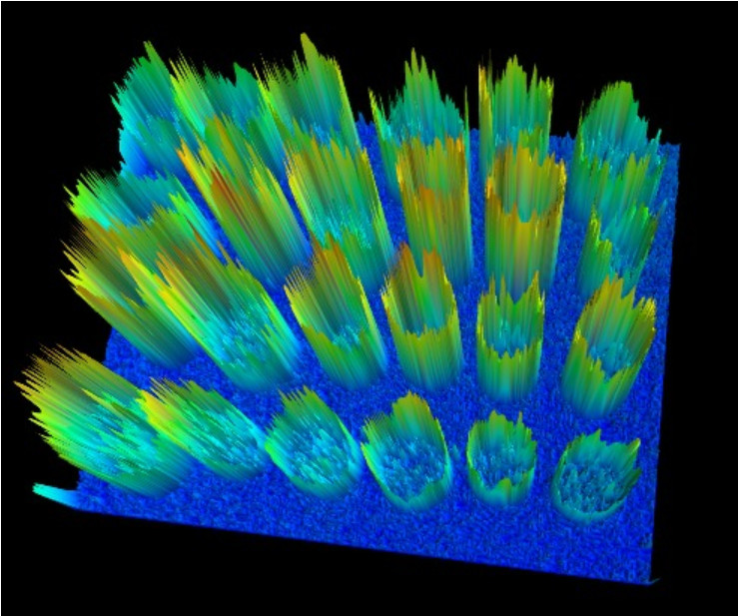
Region-based Segmentation
Example Image:
1) Determine markers (labelled pixels) specific to the coin and background
2) Perform a watershed transformation on the labelled pixels
3) Determine the catchment basins based on watershed transform
- Calculate the amplitude of the pixel gradient from the markers
- Connect markers of high intensity to determine boundaries
Background and coin pixels share enough grey levels that a thresholding segmentation would not perform well
http://scikit-image.org/docs/stable/user_guide/tutorial_segmentation.html
https://en.wikipedia.org/wiki/Watershed_%28image_processing%29
Notes:
Markers: - pixels that we can label unambiguously as either object or background.
- found at the two extreme parts of the histogram of grey values
Watershed transformation: - floods an image of elevation starting from markers, in order to determine the catchment basins of these markers
- Aim is to have high barriers effectively separate the coins from the background.

Slide 14
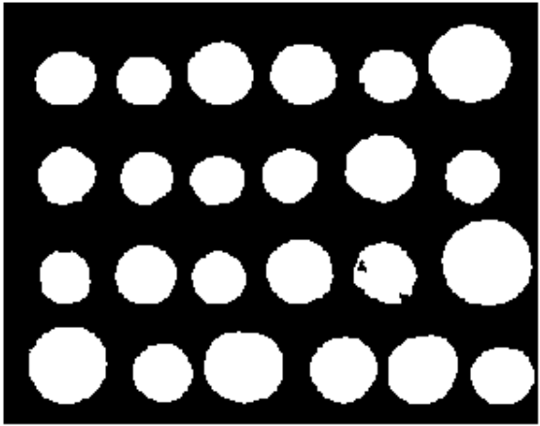

Region-based Segmentation
Example Image:
1) Determine markers (labelled pixels) specific to the coin and background
2) Perform a watershed transformation on the labelled pixels
3) Determine the catchment basins based on watershed transform
- Calculate the amplitude of the pixel gradient from the markers
- Connect markers of high intensity to determine boundaries
Background and coin pixels share enough grey levels that a thresholding segmentation would not perform well
4) Remove any small “holes” in the image
5) Label regions of interest
http://scikit-image.org/docs/stable/user_guide/tutorial_segmentation.html
https://en.wikipedia.org/wiki/Watershed_%28image_processing%29
Notes:
Markers: - pixels that we can label unambiguously as either object or background.
- found at the two extreme parts of the histogram of grey values
Watershed transformation: - floods an image of elevation starting from markers, in order to determine the catchment basins of these markers
- Aim is to have high barriers effectively separate the coins from the background.

Slide 15
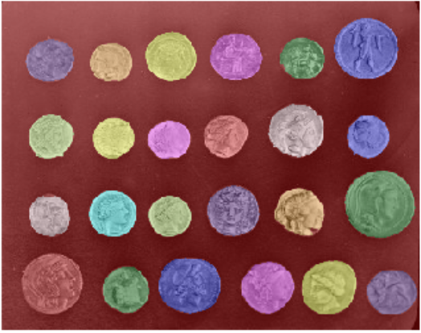
Region-based Segmentation
Example Image:
1) Determine markers (labelled pixels) specific to the coin and background
2) Perform a watershed transformation on the labelled pixels
3) Determine the catchment basins based on watershed transform
- Calculate the amplitude of the pixel gradient from the markers
- Connect markers of high intensity to determine boundaries
Background and coin pixels share enough grey levels that a thresholding segmentation would not perform well
4) Remove any small “holes” in the image
5) Label regions of interest
http://scikit-image.org/docs/stable/user_guide/tutorial_segmentation.html
https://en.wikipedia.org/wiki/Watershed_%28image_processing%29
Notes:
Markers: - pixels that we can label unambiguously as either object or background.
- found at the two extreme parts of the histogram of grey values
Watershed transformation: - floods an image of elevation starting from markers, in order to determine the catchment basins of these markers
- Aim is to have high barriers effectively separate the coins from the background.

Slide 16
Region-based Segmentation
Advantages:
Can resolve boundaries that edge-based segmentation can miss
Segmentation is not dependent solely on drawn edges
Disadvantages:
Not as robust with images with poorly defined regions
Images taken with poor lighting can result in unnecessary errors in segmentation
http://scikit-image.org/docs/stable/user_guide/tutorial_segmentation.html
https://en.wikipedia.org/wiki/Watershed_%28image_processing%29
Notes:
Markers: - pixels that we can label unambiguously as either object or background.
- found at the two extreme parts of the histogram of grey values
Watershed transformation: - floods an image of elevation starting from markers, in order to determine the catchment basins of these markers
- Aim is to have high barriers effectively separate the coins from the background.

Slide 17
Random walk segmentation
Determines the segmentation of an image from a set of markers labeling several phases (2 or more)
The algorithm solves the anisotropic diffusion equation at infinite times for sources placed on markers of each phase in turn.
A pixel is labeled with the phase that has the greatest probability to diffuse first to the pixel.

Slide 18
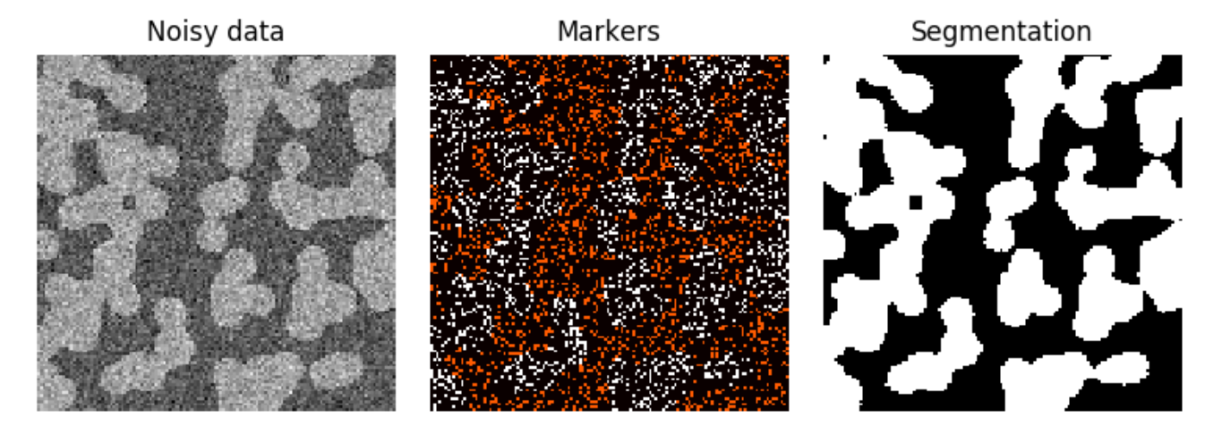
Why is this useful?
Helps in segmentation if the image is too noisy to perform histogram based segmentation
We can determine markers of the two phases from the extreme tails of the histogram of gray values, and use the random walker for the segmentation.

Slide 19
skimage.segmentation.random_walker
Input Parameters-
data – grayscale image to be segmented
Labels - array of seed markers labelled positive integers, of same shape as data without channels dimension
Beta – penalization coefficient for random walker
Mode – brute force, conjugate gradient, etc
Output – ndarray

